Slide 1

Security Design
SECURITY DESIGN FOR
IT BIZ SOLUTIONS 2025
By Manuel Perez
Milestones International College - Feb 23th - 2025

Slide 2

IT BIZ SOLUTIONS
Offers technological solutions and services to its clients in the areas of:
IT Services (Soft & Hard)
Cyber-security Services
EMAIL Services
Marketing Services
Support & Tranning Services

Slide 3
IT BIZ SOLUTIONS
IT Biz Solutions transforms information technology into business advantages
The company offers different services:
Managed IT Services,
Managed Continuity,
Managed Workstations,
Hardware Sales and Maintenance,
Managed Email Service,
Managed Security Services,
Digital Marketing Services such as Website Design and Training

Slide 4
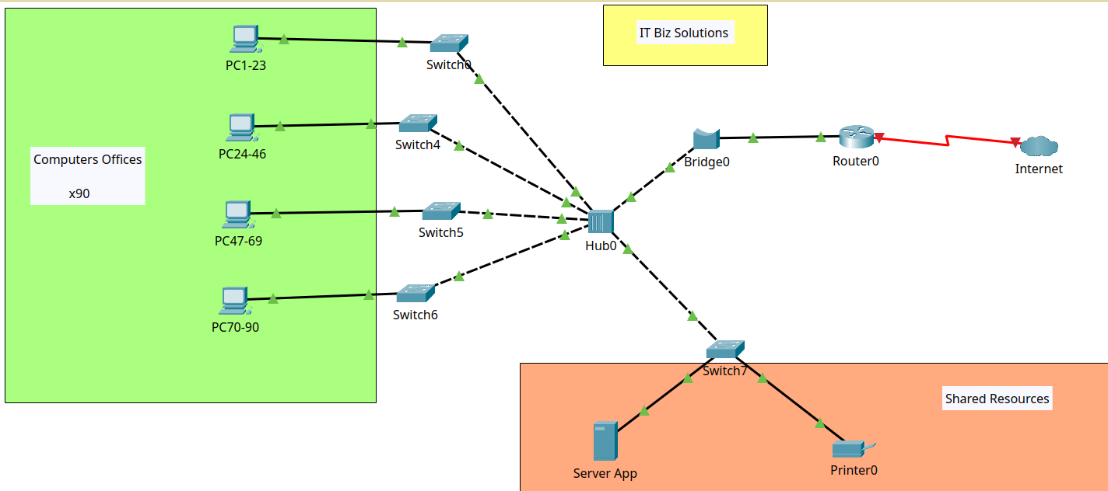
NETWORK DESIGN

Slide 5
NETWORK DESIGN
QUANTITY | TYPE
90 | PC
5 | Switch
1 | Hub
1 | Bridge
1 | Router
1 | IPS Connection
1 | Server App
1 | Printer
Network details
Type: LAN (Local Area Network)
Topology: Star

Slide 6
IDENTIFIED ISSUE
WORK PLAN
Overload bandwidth
poor segmentation
lack of security against DDoS attacks
shared server for applications and storage
High network congestion in working hours.
Evaluate current network
Develop and implement solutions to optimise traffic flow
Monitor the implemented changes and configurations
Ensure network security
Complaints

Slide 7
PLAN
PLANNED NETWORK STRATEGY
PLANNED DESIGN
Replace hubs and bridges with switches
Segment the network with VLANs
Balance the number of devices connected to the switches
Add at least one firewall
Add a backup server with disk in RAID
Segment the network by creating VLANs.
Implement Quality of Service (QoS) policies
Re-design network
Enhance network security

Slide 8
ADVANTAGES
Unnecessary network traffic will be eliminated by reducing noise across all nodes
Network security will be increased with segmentation
Bandwidth will be used in the best way
Policy Backup

Slide 9
IMPLEMENTATION
Methodology
PMBOK
INITIATING
EXECUTING
CLOSURE
Gathering infiormation:
objectives, risks, needs, assets and current policies
PLANNING
The project will be executed..
Align the company with the objectives
Cessation of activities and delivery of the performance report
CONTROL
Individual work teams
Responsible for planning the integration
Control and monitor changes to maintain quality standars

Slide 10
TO START
SUMMARY ICT ASSETS
HUMAN RESOURCES
HARDWARE
SERVICES
Human Resources
Hardware IT & ICT resources
Training resources & Recognitions, knowledge base
DATA
TALENT
SOFTWARE
Data & Information Customers and Providers
Professional talent
Human Resources

Slide 11
THREAT MODELLING
Ransomware
Social Engineering Attacks
DDoS Attack
Loss of critical information
Credential theft
Financial fraud
Loss of services
Outdated systems
No backup policy
Poor staff training
Password sec policy
Poor network proteccion
Based on international statistics,
the greatest risks for a company

Slide 12
RISK MANAGEMENT PLAN
Ransomware
Social Engineering Attacks
Regular data backups
Keep systems up to date
Endpoint protection
Regular training
Multi-factor authentication
Regular training
email filtering
Plicies for confidentiality information
Verification procedures
DDoS Attacks
Cloud-based traffic filtering
Firewalls and intrusion prevention systems
Scalable network infrastructure

Slide 13
GENERAL SECURITY POLICIES
General Legislation
Workplace Health and Safety Act 2011 code
Code of conduct
Telecommunications Code of Practice 2018
Code of conduct
Workplace Health and Safety Regulations 2021
Standard
Customer service standards

Slide 14
Focused on identified risks
PROPOSED SECURITY POLICIES
LEGISLATION
STANDARDS
CODES OF CONDUCT
GDPR
CIS Controls
OECD Code of Good Practice
NIST
PCI DSS
ISACA Code of Conduct
CCPA
MITRE ATT&CK Framework
ISC
ISO/IEC 27001

Slide 15
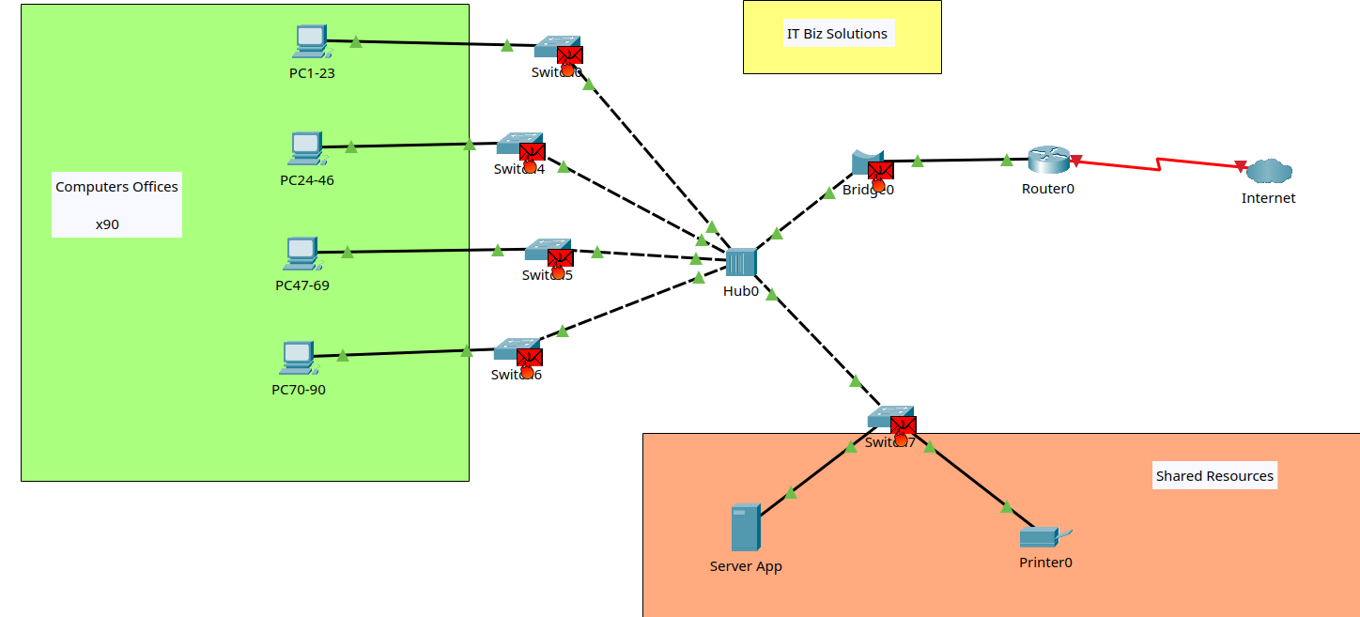
TRAFFIC CONGESTION EVAL
The packet is forwarded to all nodes in the network by the Hub. When the Bridge receives the packet, it replicates the packet and these packets are forwarded

Slide 16
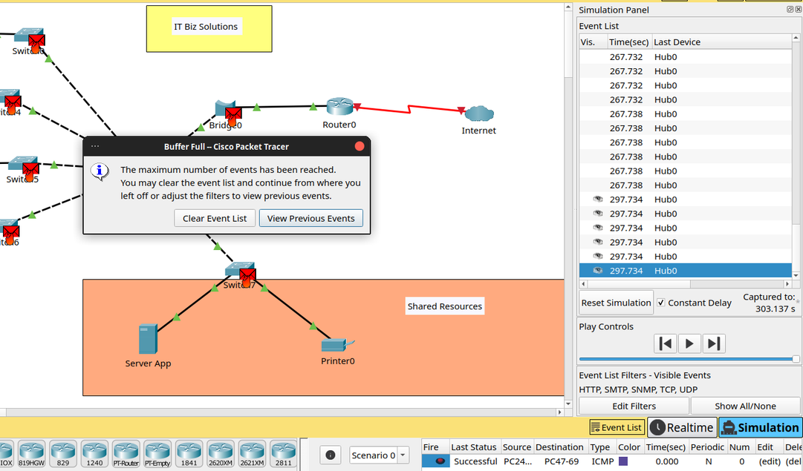
TRAFFIC CONGESTION EVAL
Even though the packet has already arrived at its destination, the network is still saturated with replicated packets.

Slide 17

PROJECTED COSTS
Duration: 3 months
Network redesign
Security training for employees on ransomware and phishing
NAS server set up to mirror backups
App server will no longer be used as a data backup

Slide 18

PROJECTED COSTS
ITEM | COST
Hardware | $18,470
Monthly Services | $3,750
Human Resources Training | $4,500
Total Project Cost | $26,720

Slide 19
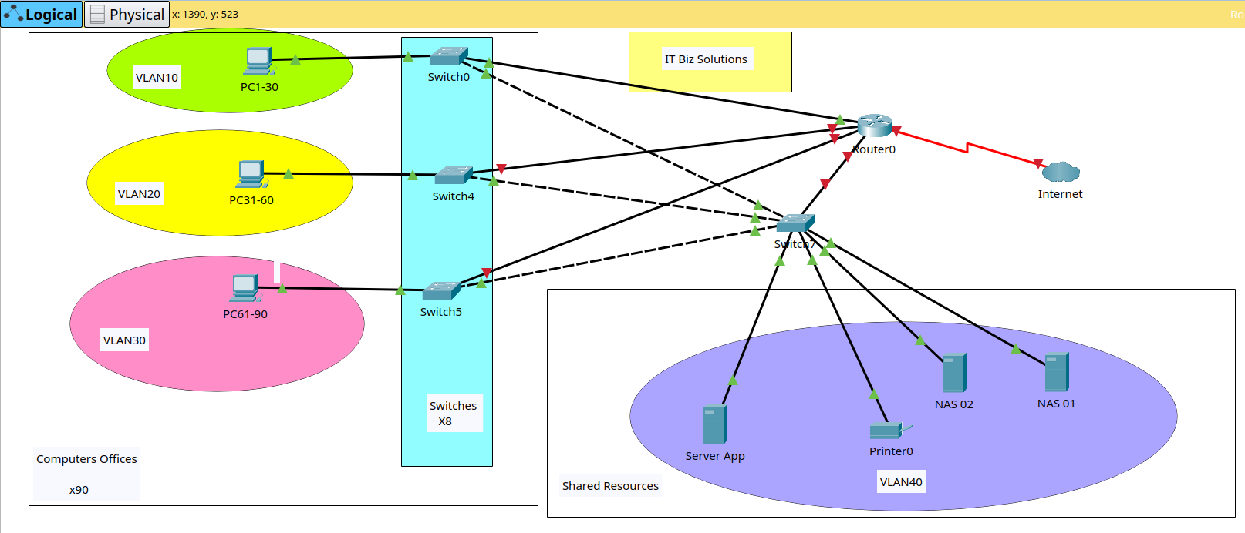
PROPOSAL NETWORK DESIGN
For simplicity, PCs and switches are grouped together

Slide 20
PROPOSAL NETWORK DESIGN
QUANTITY | TYPE
90 | PC
9 | SWITCH
2 | NAS
1 | ROUTER
1 | ISP Connection
2 | Server App
1 | Printer
Network details
Type: LAN (Local Area Network)
Topology: Star

Slide 21


